Slide 1
Navigating Market Turbulence

Slide 2
Agenda
1
What Just Happened?
4
4 Tips For Navigating Rocky Waters
2
What Does This Mean For Business
5
Finding the Right Solution
3
How Will You Recover?
Notes:
Notes: Period of market volatility have peppered the past century. As many investors know, these ups and down can wreak havoc on our portfolios and emotions. However, history has shown that in times of turmoil, sticking to a disciplined strategy can pay off. This presentation will arm you with the perspective and strategies needed to sail through market turbulence – and find opportunity in volatility.
Here are the main five topics for finding opportunity in market volatility.

Slide 3
What Just Happened?

Slide 4

Greatest Shock We’ve Ever Seen
Most impactful economic event in modern history
“…on a scale we have
never seen before”
François-Philippe Champagne, Foreign Affairs Minister e
Notes:
This has been an unprecedented time for all of us. Since the outbreak of COVID-19, our lives have drastically changed with government imposed self-isolation and quarantine. Global economic prospects have been significantly impacted because much of the world is confined to their homes and many businesses are forced to shutdown. The ripple effect of these measures to reduce the spread of the virus has been felt throughout the economy with corporate earnings now under pressure.
Policymakers around the world have pushed out an extraordinary amount of fiscal and monetary support to combat the major economic contraction that we are suddenly faced with. We have seen 3 rate cuts in Canada since the outbreak as well as a significant emergency relief program. Globally, many central banks have also cut their interest rates and delivered a historical level of relief packages to alleviate strain on individuals, businesses, vulnerable industries, and financial markets.

Slide 5
Greatest Economic Event In a Generation
Experts Calling for a Recession
Notes:
And the economic impact is significant and most experts are calling for a recession

Slide 6
Significant Equity Market Selloff
A challenging and wild ride since the outbreak began
Volatility Index (VIX)
Stock Market YTD 2020 Return*
2008 Financial Crisis
COVID-19
U.S. Debt
Ceiling Impasse
Grexit
Oil Crisis
Trade Wars
Source: Bloomberg and Morningstar as of March 31th, 2020
* For illustrative purposes only. Indices are not managed and it is not possible to invest directly in an index. Assumes reinvestment of all income and no transaction costs, fees or taxes. Percentage market gain/loss based on returns from the FTSE Canada Universe Bond Index (Canadian Fixed Income), MSCI EAFE GR (International Equities (C$), S&P 500 TR (U.S. Equities (C$), S&P/TSX Composite (Canadian Equities (C$), and Oil index is WTI Index from January 1st to March 31th, 2020. Returns are calculated in Canadian currency.
Notes:
Since the beginning of February, there has been a steep and broadbased selloff across all market segments. The chart on the left is the VIX Index which is a volatility measure for U.S. equities. As you can see, market volatility triggered by coronavirus was as severe as what we saw during the 2008/09 Financial Crisis.
The chart on the right shows that the year-to-date amount of selloff across various market segments. Oil was leading losses with WTI falling over 67% as a result of a price war between Saudi Arabia and Russia.
Global equity markets, including US, International and Canadian equities, all sold off dramatically. The fixed income market, on the top line, provided a much needed offset in this period with a small gain and has helped provide downside protection for balanced investors.

Slide 7

Global Economies Derailed by Exogenous Shock
Policy makers race to provide relief
Economic Impact
COVID-19 pandemic has led to government-enforced isolation measures across the globe
Corporate earnings under significant pressure as economic activities came to a halt
Policy Response
Coordinated actions taken by policymakers across the globe via both monetary and fiscal policies:
1.50%
1.50%
Canadian policy rate cut
U.S. policy rate cut
0.25% Fed funds rate
0.25% BoC Target Rate
U.S. Relief Package:
$2 Trillion
Canada Emergency Response Benefit:
$107 Billion
Source: Bank of Canada, the U.S. Federal Reserve. As of March 31, 2020.
The target range for the federal funds rate is 0.00-0.25%, with 0.25% reflecting the upper limit.
Notes:
This has been an unprecedented time for all of us. Since the outbreak of COVID-19, our lives have drastically changed with government imposed self-isolation and quarantine. Global economic prospects have been significantly impacted because much of the world is confined to their homes and many businesses are forced to shutdown. The ripple effect of these measures to reduce the spread of the virus has been felt throughout the economy with corporate earnings now under pressure.
Policymakers around the world have pushed out an extraordinary amount of fiscal and monetary support to combat the major economic contraction that we are suddenly faced with. We have seen 3 rate cuts in Canada since the outbreak as well as a significant emergency relief program. Globally, many central banks have also cut their interest rates and delivered a historical level of relief packages to alleviate strain on individuals, businesses, vulnerable industries, and financial markets.

Slide 8
Historic Correction and Recovery
May be the beginning of a recovery
Notes:
Given the current correction the market has seemed to bottomed and has started to recover but it’s very hard to know if the market can go lower.

Slide 9
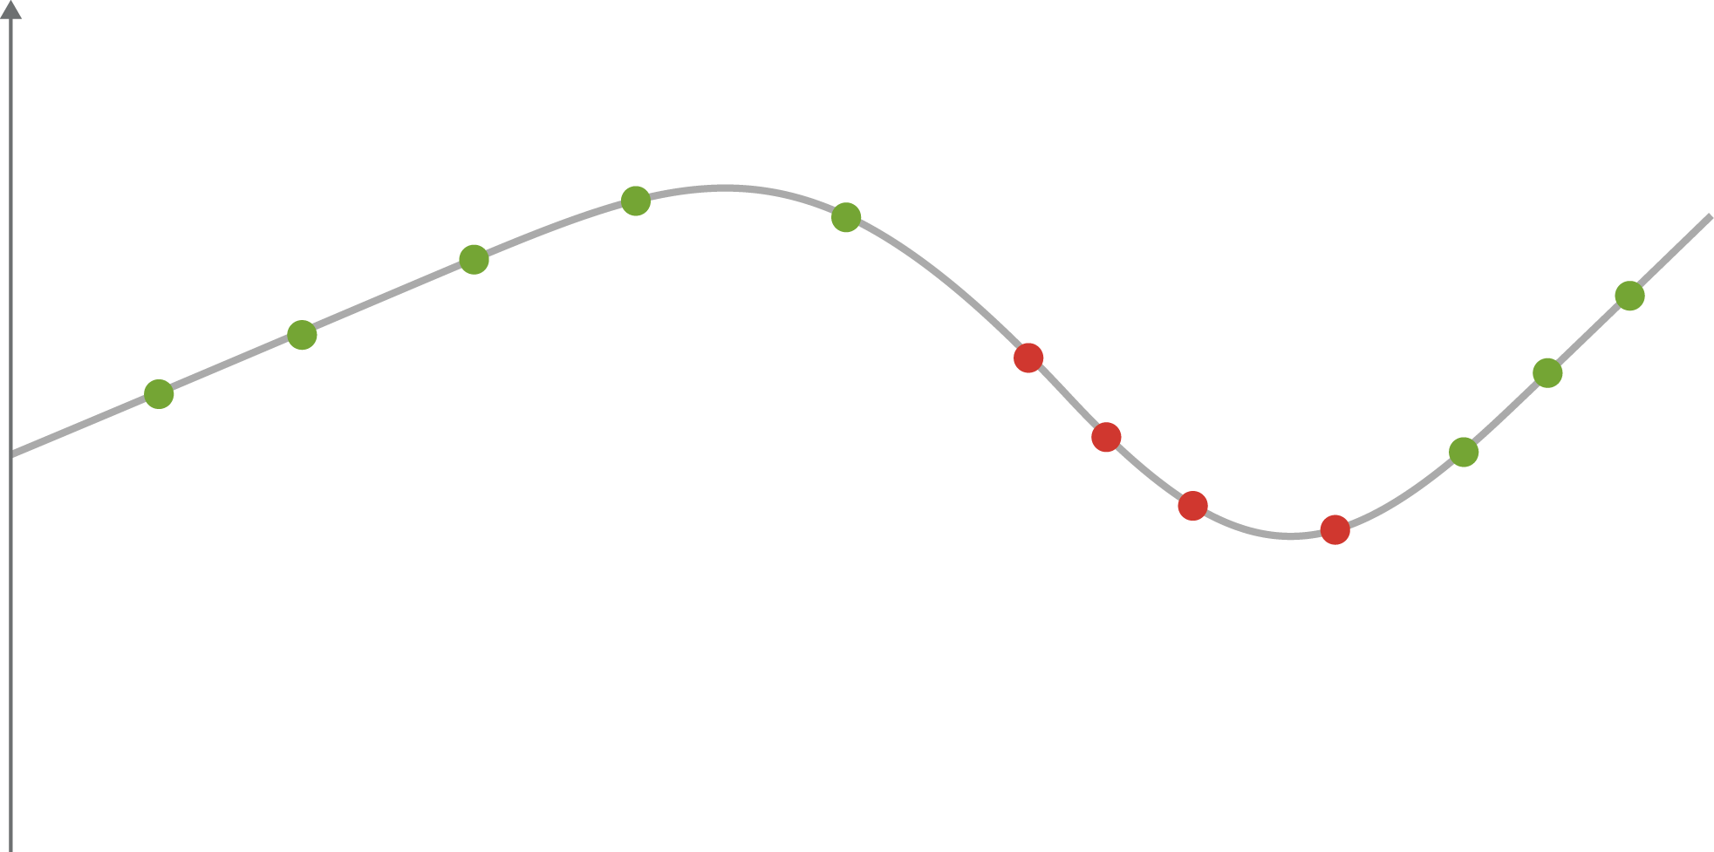
The Cycle of Emotional Investing
Avoid letting your emotions guide your investing
Good thing
I didn’t wait any longer
Just a small setback… I could always invest more
I’ve missed some gains… but I’m going to buy
Looks like there is real support… I’ll invest soon
I don’t want to completely miss out… at least prices are lower than last time
It’s still early days…I’ll keep my eye on the market
Point of Maximum Risk
It can’t go any lower… can it?
Market performance
Seriously?
I’ll sell when
I’m above water!
Wait a minute!
I’m out
Told you so… good thing
I got out when I did
Point of Maximum Fear
Source: Darst, David M. (Morgan Stanley and Companies, Inc.). The Art of Asset Allocation, 2003.
Notes:
Notes: Emotional investing is easy to fall into, but it can wreak havoc on any portfolio. Often the best and worst times to invest are the very opposite of what our emotions tell us we should be doing.”
Investors generally feel a financial loss about 2.5x more than a gain of the same magnitude.
Volatility can create fear in investors as the swings in price can feel like a rollercoaster. Behavioural economists call this emotional rollercoaster “The Cycle of Market Emotions”.
Behavioural Finance tells us that individuals tend to buy and/or sell at the wrong time. For instance, a fast rising market can attract investors to purchase near the top, while a rapidly declining market can cause them to sell near lows.
These emotional biases can interfere with attaining your long-term goals

Slide 10
What Does This Mean For Business?

Slide 11


How Might This Change Things?
New Ways of Doing Business
The Internet of Things
Government Intervention
Rethinking Health
Anti-globalization
Notes:
According to our internal managers the 5 big socio-economic effects could be the following

Slide 12
What Might It Mean For Various Industries?
Energy
Consumer Goods
Low demand for oil
Higher demand for online stores; less demand for brick and mortar business, and travel
Healthcare
Technology
Higher demand for basic medical products
Increased demand for cloud and remote computing; higher demand for online entertainment
Materials
Real Estate
Inflation and higher prices in Gold /Silver
Less demand for commercial real estate
Notes:
And how can these big changes effect various industry demand

Slide 13
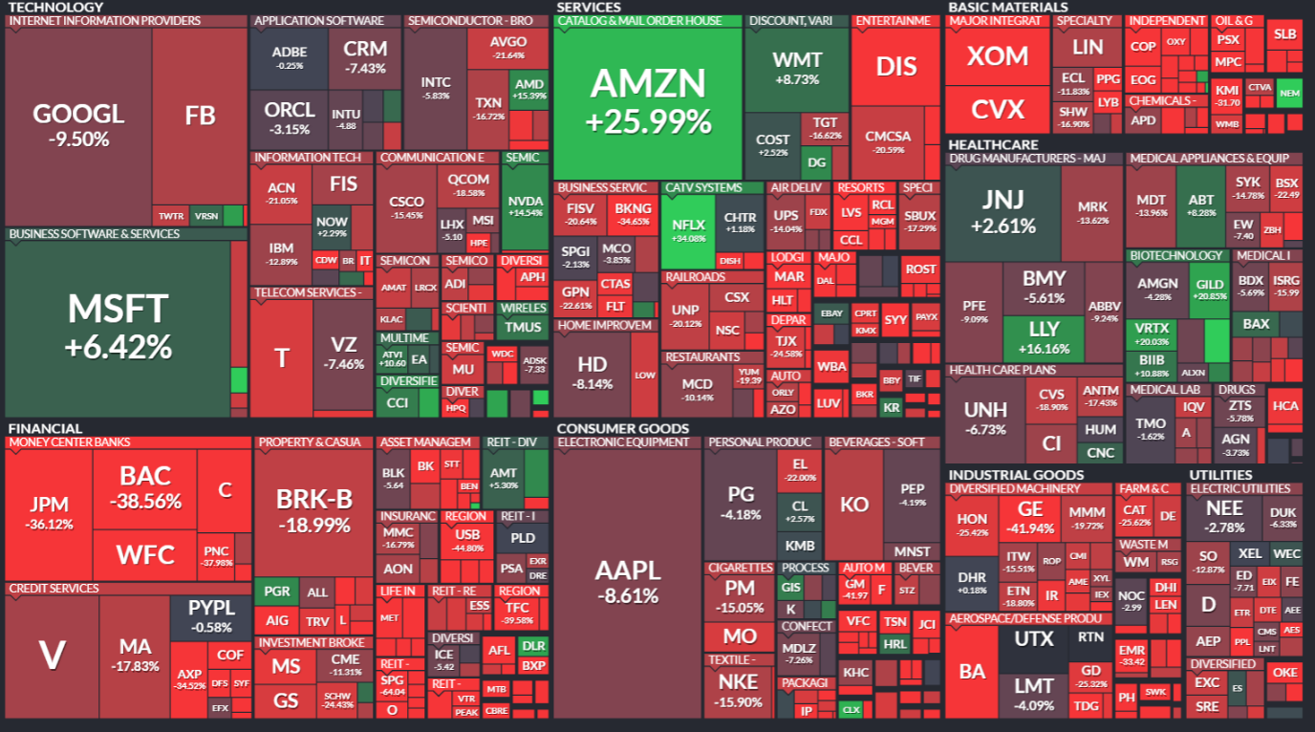
Year to Date Performance of Companies is Varied
Source: finviz.com, April 22 2020
Notes:
This is a mosaic of ytd performance. Not all companies have gone down as you can see different industries and company stock have done very well

Slide 14
How Will You Recover From?

Slide 15
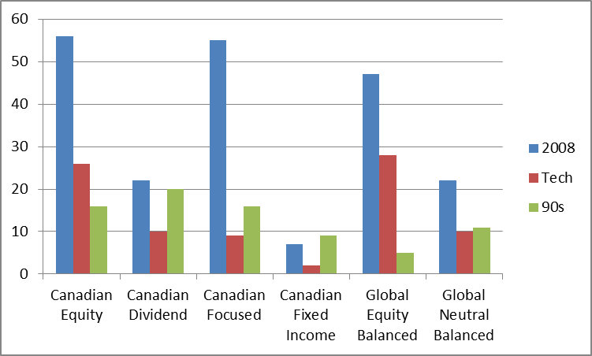
How Long Does it Take Markets to Recover?
The average recovery period has been 14 months in a global balanced portfolio
Source: Morningstar, “A look at past drawdowns”
Notes:
According to morningstar the average recovery period for a global portfolo has been 14 months

Slide 16
Short-Term Pain, Long-Term Gain
Stay invested to avoid missing the initial stages of a market recovery
Bear Market
1 Year After
3 Years After
5 Years After
-22%
Jan/69–June/70
27%
56%
56%
-30%
Feb/74–Nov/74
21%
39%
155%
-39%
June/81–June/82
87%
123%
227%
-23%
July/87–Jan/88
19%
23%
29%
-20%
Dec/89–Oct/90
19%
53%
68%
-27%
Apr/98–Aug/98
28%
40%
47%
-43%
Aug/00–Sept/02
22%
88%
153%
-43%
May/08–Feb/09
48%
69%
102%
Recent Down Market
-17%
Mar/11-Sept/11
9%
41%
49%
-14%
Apr/15-Jan/16
24%
32%
Source: Bloomberg. For illustrative purposes only . Indices are not managed and it is not possible to invest directly in an index. Assumes reinvestment of all income and no transaction costs, fees or taxes. Percentage market gain/loss based on monthly compounded returns from the S&P/TSX Composite Total Return Index from January 31, 1957 to December 31, 2019. Returns are calculated in Canadian currency. In the above illustration, the generally accepted measure of a market decline of 20% or more over any given period has been adopted to characterize a bear market.
Notes:
While the sharp and sudden market selloff was unsettling in the first quarter of 2020, it is important to remember that the pandemic will be over, at which point the economy will recover.
Looking back at previous selloffs, the markets have been tested before. Markets do recover in time, and major declines have generally been followed by major recoveries. Recoveries can be sharp and can happen quickly and being out of the market when stocks rally can be just as punishing as the selloff. The potential cost of missing the initial stages of a recovery could leave a lasting impact on your long-term investment returns.

Slide 17
Tips For Navigating in Rocky Waters

Slide 18
Tips For Navigating in Rocky Waters
Invest with Advice
Stay Diversified
Be Patient and Stay Calm
Seek Legitimately
Active Management®
01
02
03
04
Notes:
We will get through this pandemic, but volatility is likely to remain high in the short-term. Throughout this period, there are a few things that you can do to help you stay grounded.
Invest with advice: Have an advisor guide to attain your goals
Stay Diversified: Ensure that your portfolio is balanced and in-line with your longer-term goals.
Be patient: Market downturns don’t last forever. Stay invested to participate in the recovery.

Slide 19



Tip 1: Invest with advice
Wealth accumulation: Investing with advice over the long term pays off
1
2.73x
more wealth accumulated
1.99x
more wealth accumulated
1.58x
more wealth accumulated
4-6 years
7-14 years
More than 15 years
Source: New Evidence on the Value of Financial Advice, IFIC 2012.
Source: Bloomberg. Percentage market gain/loss based on monthly compounded returns from the S&P/TSX Composite Total Return Index from December 31, 1956 to
December 31, 2018. Returns are calculated in Canadian currency. Assumes reinvestment of all income and no transaction costs or taxes. The terms bull market and bear market describe upward and downward market trends, respectively. Bull markets are movements in the stock market in which prices are rising and the consensus is that prices will continue moving upward. Bear markets are the opposite – stock prices are falling, and the view is that they will continue falling. In the above illustration, the generally accepted measure of a price increase or decline of 20% or more, respectively, over any given period, has been adopted.
Notes:
Notes: Academic research indicates that households that have a financial advisor save at twice the rate compared to those that don’t. What’s more, the same research has shown that over the long term, investor who work with an advisor accumulate almost three times more assets than those who don’t.
Financial advisors help people increase their wealth… and the longer people have advice, the more their investments grow.

Slide 20
Tip 2: Stay Diversified
When it comes to reducing risk and minimizing portfolio volatility
2
YTD Returns of Hypothetical Canadian Portfolio
Staying diversified creates a better risk-return profile
50% Equity/50% Fixed Income
100% Equity
Source: Morningstar. For illustrative purposes only. Returns are based upon average YTD returns ending March 31st, 2020. 100% Equity portfolio invested in S&P/TSX Composite Total Return Index; 50% Equity/50% Fixed Income portfolio invested in 50% FTSE Canada Universe Bond Index and 50% S&P/TSX Composite Total Return Index. Indices are not managed and it is not possible to invest directly in an index. Assumes reinvestment of all income and no transaction costs, fees or taxes.
Notes:
Bonds are an important diversifier, they provide downside protection during equity market stress.
As you can see, a portfolio with more exposure to fixed income has held up meaningfully better and helped mitigate volatility during equity market stress over the first quarter of this year.
Rebalancing your portfolio is also just as important. If the equity portion in your portfolio has drifted higher over the last few years, then the negative impact from the downturn this quarter would be greater. A well diversified portfolio with regular rebalancing would ensure that your portfolio remains aligned with your risk tolerance and long term goals.

Slide 21
Make Diversification Work for You
2010 | 2011 | 2012 | 2013 | 2014 | 2015 | 2016 | 2017 | 2018 | 2019
38.5% | 9.7% | 16.0% | 48.1% | 23.9% | 21.6% | 35.4% | 28.7% | 7.7% | 24.8%
20.2% | 8.3% | 15.3% | 41.3% | 14.4% | 19.5% | 21.1% | 17.4% | 4.2% | 22.9%
17.6% | 6.8% | 13.8% | 31.6% | 11.2%* | 16.2% | 17.1% | 13.8% | 2.5% | 19.2%
13.0% | 4.6% | 13.4% | 13.3%* | 10.6% | 14.6% | 12.3% | 9.1% | 1.4% | 19.2%
10.1%* | 0.4%* | 7.9%* | 13.0% | 9.7% | 6.5% | 8.2%* | 8.9% | -2.0%* | 16.5%
9.1% | -1.8% | 7.2% | 7.8% | 8.8% | 4.4%* | 8.1% | 8.2%* | -3.0% | 16.1%*
6.7% | -8.7% | 3.6% | 4.3% | 7.0% | 3.5% | 7.7% | 7.1% | -5.6% | 12.9%
3.5% | -9.6% | 3.1% | 3.9% | 5.4% | 2.4% | 1.7% | 6.4% | -6.5% | 6.9%
2.6% | -14.2% | 2.5% | 3.8% | 4.1% | -8.3% | -1.5% | 2.5% | -8.9% | 1.5%
0.0% | -16.2% | 2.0% | -1.2% | -0.1% | -13.8% | -2.0% | 0.3% | -18.2% | 1.4%
Calendar year returns (in Canadian dollars)
21
21
HIGHEST
By including exposure to
a variety of asset classes, company sizes, sectors and geographies within your portfolio
LOWEST
 | Asset class | Index
 | Canadian Small Cap | BMO Small Cap Index
 | U.S. Equities | S&P 500 Index
 | Canadian Equities | S&P 500 Composite Total Return Index
 | Canadian Bonds | FTSE Canada Universe Bond Index
 | International Equities | MSCI EAFE Index
 | Emerging Markets | MSCI Emerging Markets Free Index
 | U.S. Small Cap | Russell 2000 Index
 | Global Bonds | Barclays Global Aggregate Bond Index
 | Canadian Home Prices | Teranet National Bank Composite House Price Index – Composite 11
 | Balanced Portfolio | 40% FTSE Canada Universe Bond Index, 30% S&P/TSX Composite Total Return Index, 30% MSCI World Index
* Balanced Portfolio
Notes:
Beyond asset allocation, the other layers of diversification are also important. The variability of returns are high between asset classes, company size, sectors and geographies. They are hard to predict, and they don’t always move in the same direction. Exposure to a variety of these investments can create a balanced portfolio with lower volatility than a portfolio associated with just 1 asset class.
This is going to be vitally important coming out of the Covid-19 crisis to take full advantage of a market recovery.

Slide 22
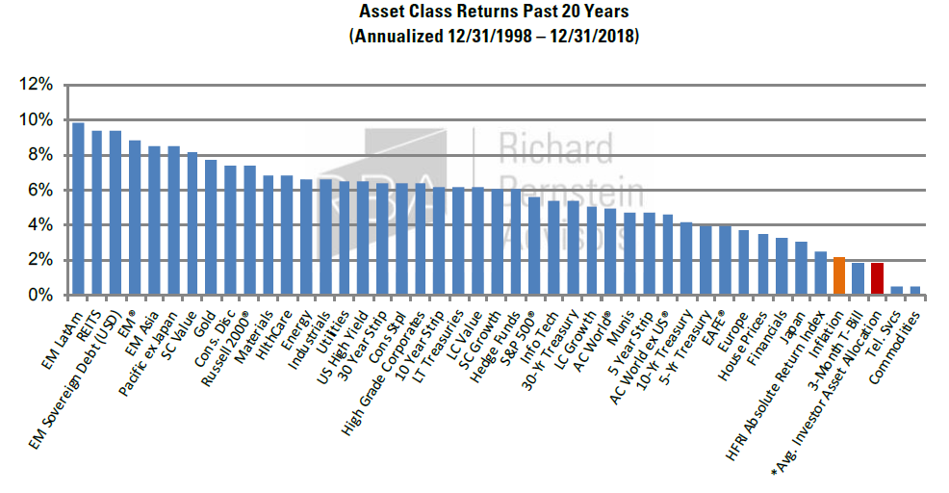
Average Investor Performance
The average investor has had the worst returns
Notes:
The average investor has had some of the worst returns

Slide 23

Tip 3: Be Patient and Stay Calm
3
$10,000 investment from November 2008 – November 2018
$22,049
$14,752
$11,102
$8,652
Continuously
invested
Missed
10 best days
Missed
20 best days
Missed
30 best days
Source: Bloomberg. S&P/TSX Composite Total Return Index, November 30, 2008 to November 30, 2018. It is not possible to invest directly in an index. Assumes reinvestment of all income and no transaction costs or taxes. Value of investment calculated using compounded daily returns. Missing 10, 20 and 30 best days, excludes the top respective return days..
Notes:
This is an example of having missed the markets

Slide 24
Tip 3: Be Patient and Stay Calm
Potential buying opportunities following painful declines
3
S&P 500 Quarterly Performance (USD) : 1928- Present
Top 10 Worst Returns | Dates | Quarterly Return | +4 Qtr
1 | Jun. 30, 1932 | -39.4% | 146.3%
2 | Sep. 30, 1931 | -34.5% | -16.8%
3 | Dec. 31, 1929 | -28.9% | -28.5%
4 | Sep. 30, 1974 | -26.1% | 32.0%
5 | Dec. 31, 1937 | -23.3% | 24.5%
6 | Dec. 31, 1987 | -23.2% | 12.4%
7 | Dec. 31, 2008 | -22.6% | 23.5%
8 | Jun. 29, 1962 | -21.3% | 26.7%
9 | Mar. 31, 2020 | -20.0% | –
10 | Mar. 31, 1938 | -19.4% | 29.2%
Avg | – | -25.9% | 27.7%
Median | – | -23.3% | 24.5%
BOTTOM LINE:
While we don’t know when we are hitting a market bottom in real-time, history has shown us that the quarters following a drawdown can be rewarding.
Source: 1832 Asset Management, Bloomberg.
Notes:
This is an example of having missed the markets

Slide 25


Tip 4: Seek Legitimately Active Management
4
In periods of volatility, active management can pay off because portfolio managers have the ability to select holdings that have potential to:
Protect on the downside
Provide faster recovery when markets turnaround
1
2
Source: Dynamic Funds.
Source: Government of Canada benchmark bond yields – 10 year | Bank of Canada
Notes:
What can legitimately active management do for you in a volatile market :
Protect on the downside
Potential faster recovery

Slide 26
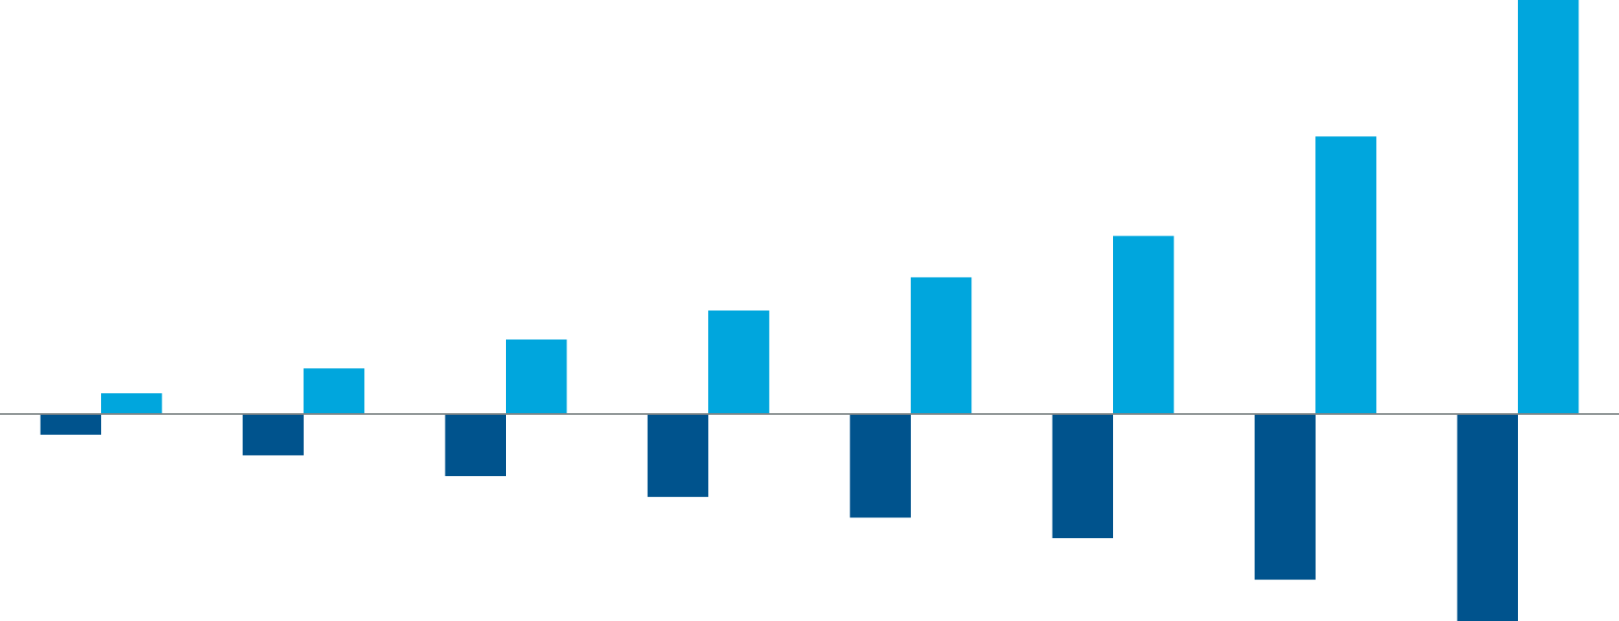
How Much Do You Need to Recover?
Why Active Management matters
This is important because it often takes a significantly higher return to recover from a loss suffered. For example, a 50% drop in price requires a 100% return just to get back to where you started.
100%
Return loss (%)
67%
Return needed to recover from loss (%)
43%
33%
18%
25%
Investment required ($1,000)
11%
5%
-5%
-10%
-15%
-20%
-25%
-30%
-40%
Source: Dynamic Funds.
Source: Government of Canada benchmark bond yields – 10 year | Bank of Canada
-50%
Notes:
Let’s look at the math of a loss and how much return you need to recover
This is why it’s important to have an active manager to minimize downside and have upside potential

Slide 27
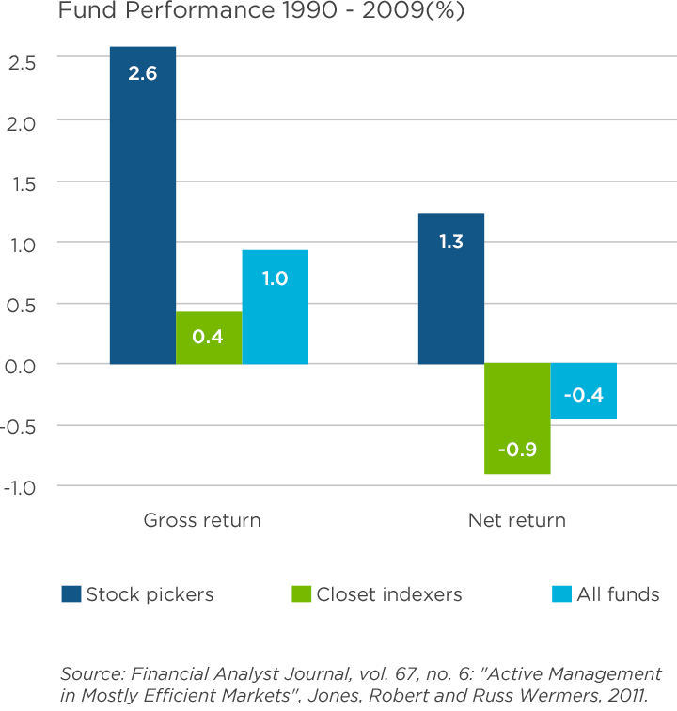
The Active Management
Difference
Stock pickers outperform
Notes:
This is a study done on how stock pickers outperform

Slide 28
Thank you
For more information, please email or call Gary or Amanda Attack.

Slide 29
Important Information
© Copyright 2020 1832 Asset Management L.P. All rights reserved. ® Registered trademarks of The Bank of Nova Scotia used under license. This presentation has been prepared by 1832 Asset Management L.P and is provided for information purposes only. Views expressed regarding a particular investment, economy, industry or market sector should not be considered an indication of trading intent of any of the mutual funds managed by 1832 Asset Management LP. These views are not to be relied upon as investment advice nor should they be considered a recommendation to buy or sell. These views are subject to change at any time based upon markets and other conditions, and we disclaim any responsibility to update such views.
Information contained in this document, including information relating to interest rates, market conditions, tax rules, and other investment factors are subject to change without notice and 1832 Asset Management L.P. is not responsible to update this information. To the extent this document contains information or data obtained from third party sources, it is believed to be accurate and reliable as of the date of publication, but 1832 Asset Management L.P. does not guarantee its accuracy or reliability. Nothing in this document is or should be relied upon as a promise or representation as to the future. Investors should consult their own professional advisor for specific investment advice tailored to their needs when planning to implement an investment strategy to ensure that individual circumstances are considered properly and action is taken based on the latest available information.
ScotiaFunds® are managed by 1832 Asset Management L.P., a limited partnership the general partner of which is wholly owned by The Bank of Nova Scotia. ScotiaFunds are available through Scotia Securities Inc. and from other dealers and advisors. Scotia Securities Inc. is wholly owned by The Bank of Nova Scotia and is a member of the Mutual Fund Dealers Association of Canada. Scotiabank® includes The Bank of Nova Scotia and its subsidiaries and affiliates, including 1832 Asset Management L.P. and Scotia Securities Inc. When you purchase mutual funds or other investments or services through or from Scotia Securities Inc., you are dealing with employees of Scotia Securities Inc. Scotiabank may also employ these individuals in the sale of other financial products and services. Activities conducted solely on behalf of Scotiabank are not the business or responsibility of Scotia Securities
Inc.
Series F units of the Pools are only available to investors who meet certain eligibility criteria and who participate in an eligible fee-based program with their registered dealer. Commissions and trailing commissions are not payable on Series F units of the Pool but management fees and expenses may be associated with these investments. Investors may also pay a Fee-Based Account Fee which is negotiated with their financial advisor and paid directly to the registered dealer. Please read the prospectus before investing. Investments in Series F units of the Funds are only available investors that participate in a fee-based program with their registered dealer. Performance results for Series F units may appear higher than for Series A units as the management fee does not include the trailing commission. Commissions, trailing commissions, management fees and expenses may be associated with mutual fund investments. Please read the prospectus before investing. The indicated rates of return are the historical annual compounded total returns including changes in units value and reinvestment of all distributions and do not take into account sales, redemption, distribution or optional charges or income taxes payable by any securityholder that would have reduced returns. Mutual funds are not guaranteed, their values change frequently and past performance may not be repeated.

